Slide 1
Computer Graphics (L04) EG678EX
2-D Algorithms

Slide 2
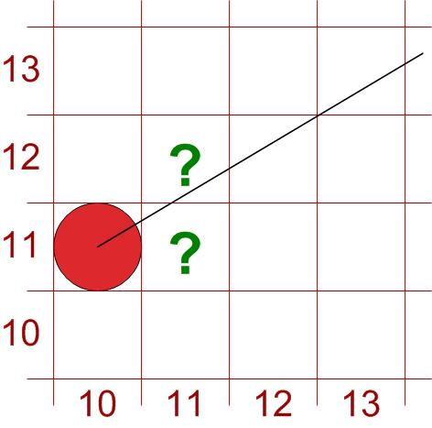
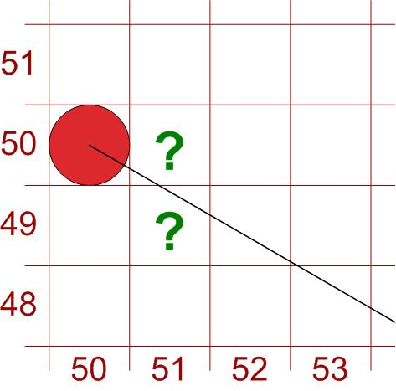
Bresenham’s Line Algorithm
Uses only incremental integer calculations
Which pixel to draw ?
(11,11) or (11,12) ?
(51,50) or (51,49) ?
Answered by Bresenham

Slide 3
For |m|<1
Start from left end point (x₀,y₀) step to each successive column (x samples) and plot the pixel whose scan line y value is closest to the line path.
After (x_{k},y_{k}) the choice could be (x_{k}+1,y_{k}) or (x_{k}+1,y_{k}+1)

Slide 4
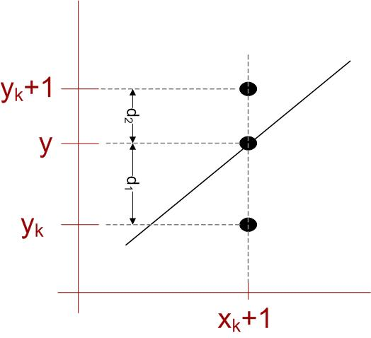
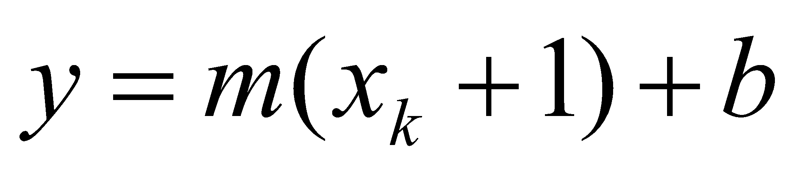
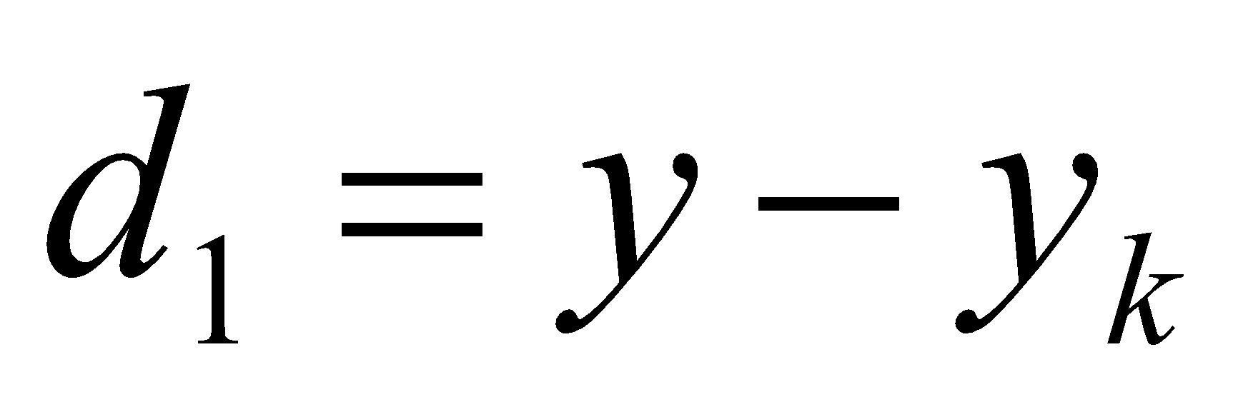
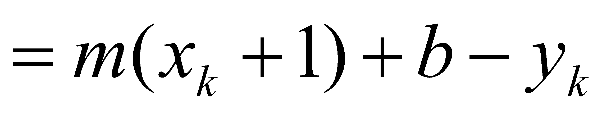
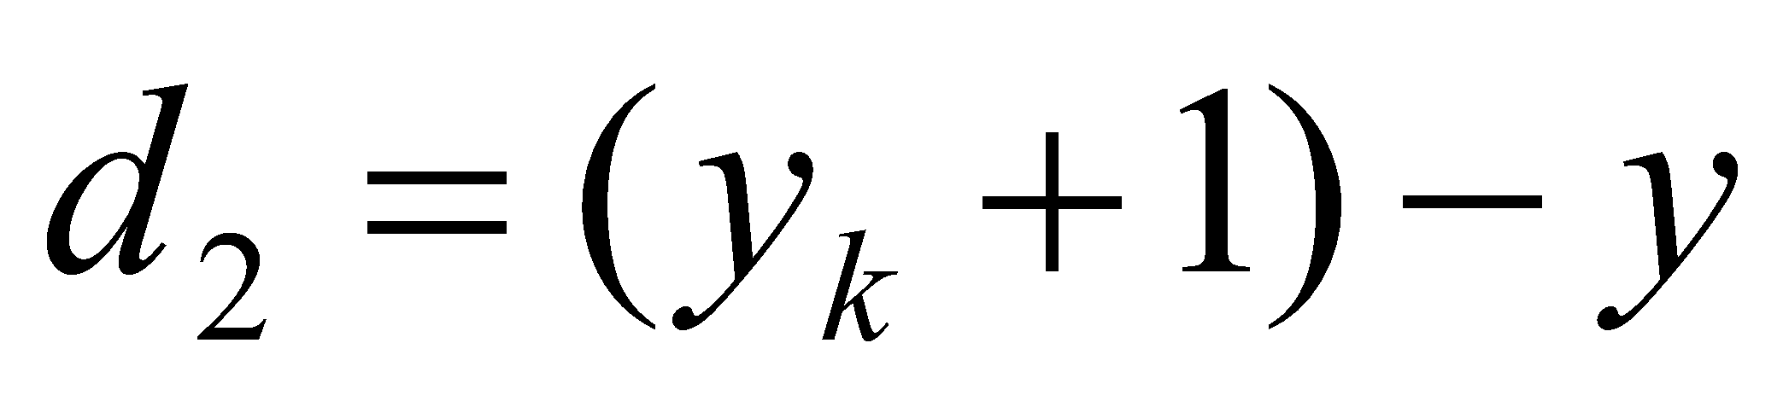
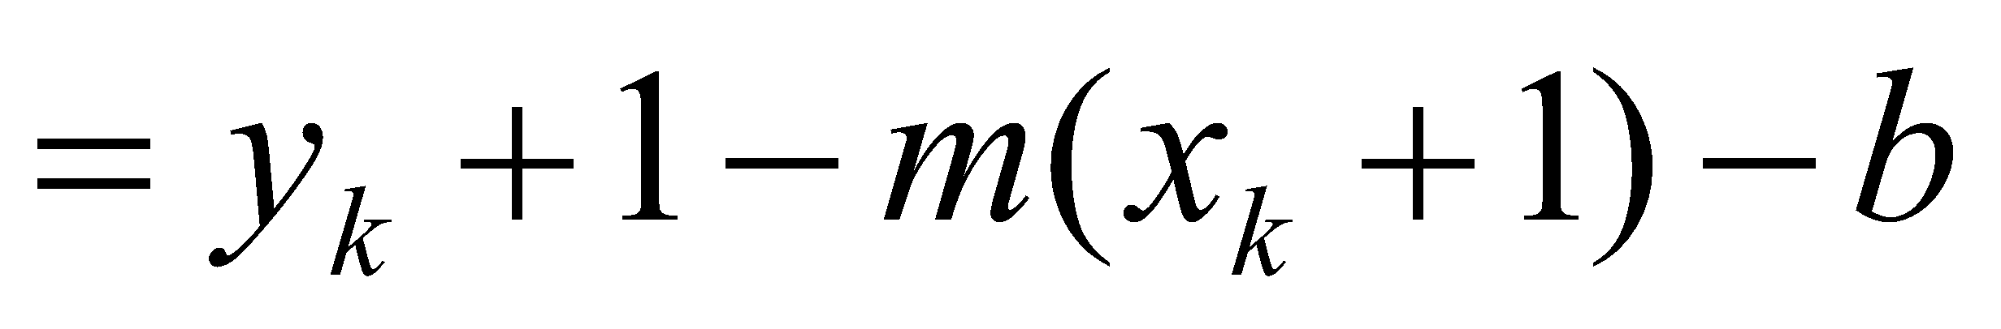
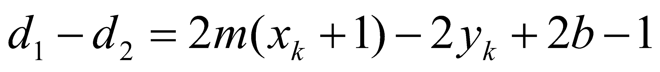
Then
And
Difference between separations

Slide 5
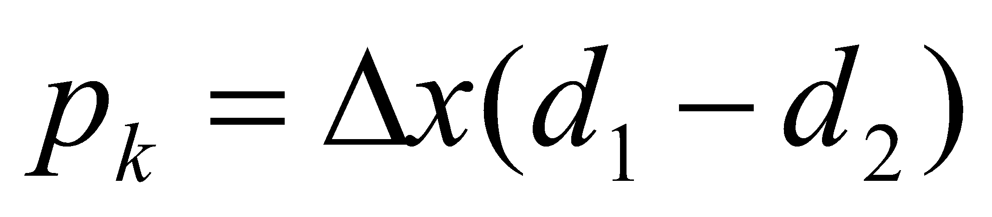
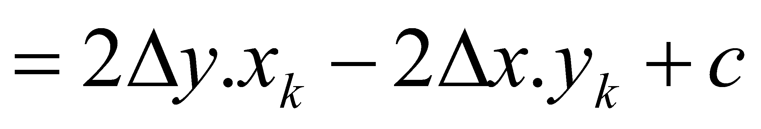
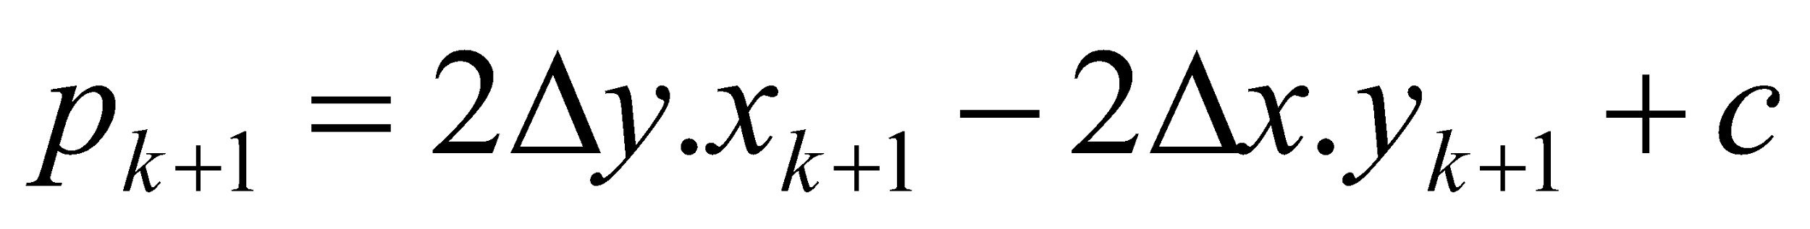
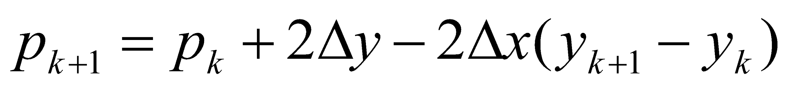
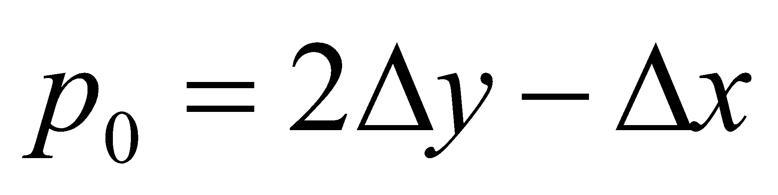
Constant=2Δy + Δx(2b-1) Which is independent of pixel position
Constant=2Δy + Δx(2b-1) Which is independent of pixel position
Defining decision parameter
[1]
Sign of p_{k} is same as that of d₁-d₂ for Δx>0 (left to right sampling)
For Recursive calculation, initially
c eliminated here
because x_{k+1} = x_{k} + 1
y_{k+1}-y_{k} = 0 if p_{k} < 0
y_{k+1}-y_{k} = 1 if p_{k} ≥ 0
Substitute b = y₀ – m.x₀
and m = Δy/Δx in [1]

Slide 6
Algorithm Steps (|m|<1)
Input the two line endpoints and store the left endpoint in (x₀,y₀)
Plot first point (x₀,y₀)
Calculate constants Δx, Δy, 2Δy and 2 Δy- 2Δx, and obtain p₀ = 2Δy – Δx
At each x_{k} along the line, starting at k=0, perform the following test:
If p_{k}<0, the next point plot is (x_{k}+1,y_{k}) and
P_{k+1} = p_{k} + 2Δy
Otherwise, the next point to plot is (x_{k} + 1, y_{k}+1) and
P_{k+1} = p_{k} + 2Δy - 2Δx
Repeat step 4 Δx times

Slide 7
What’s the advantage?
Answer: involves only the calculation of constants Δx, Δy, 2Δy and 2Δy- 2Δx once and integer addition and subtraction in each steps

Slide 8
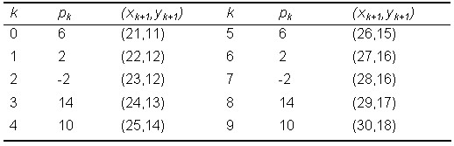
Example
Endpoints (20,10) and (30,18)
Slope m = 0.8
Δx = 10, Δy = 8
P₀ = 2Δy - Δx = 6
2Δy = 16, 2Δy-2Δx = -4
Plot (x₀,y₀) = (20,10)
Plot ?

